Slide 1
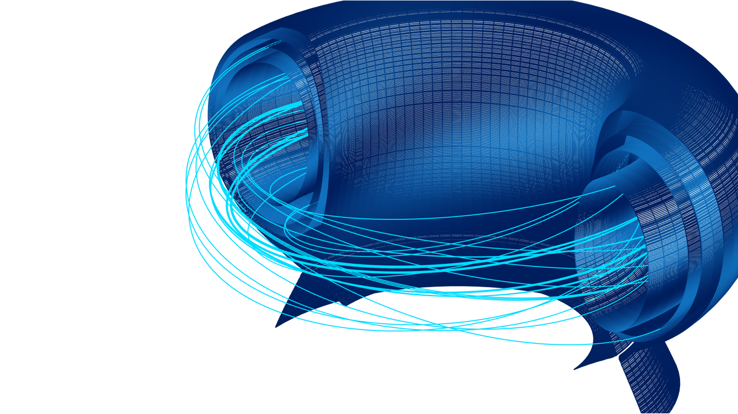


Select the modes:
Mime It
Act out the word without speaking, so others can guess it.
Forbidden
Make others guess the word without saying any forbidden words.
Draw It
Draw the word so others can guess it, without using letters or numbers.

Slide 2

Draw It

Slide 3

Mime It

Slide 4
Forbidden Words

Slide 5

Draw It

